Slide 1
Track 3: AI in Industry Usecases (Legal, Healthcare, Marketing, etc.)
Nitros
Shiven Khare
Rehatman Kaur
Hrishita Dalal

Slide 2
Problem Statement
In recent years, the sheer volume and complexity of legal documents—statutes, regulations, case law, and scholarly commentary—has made it increasingly difficult for non-experts and even seasoned practitioners to locate and interpret relevant provisions rapidly. In India, where legislation and constitutional text exist in both English and Hindi, there is a pressing need for tools to bridge the gap between dense legal language and everyday queries in the user’s preferred language.

Slide 3
Solution
This project presents a prototype Legal QA Chatbot designed to answer questions about the Indian Constitution and the Indian Penal Code (IPC) directly in Hindi, leveraging modern Retrieval-Augmented Generation (RAG) techniques and a lightweight multilingual language model. At its core, our system ingests “born-digital” Hindi texts of the Constitution and IPC—alongside curated question-answer pairs from publicly available datasets—and converts them into a searchable knowledge base.

Slide 4
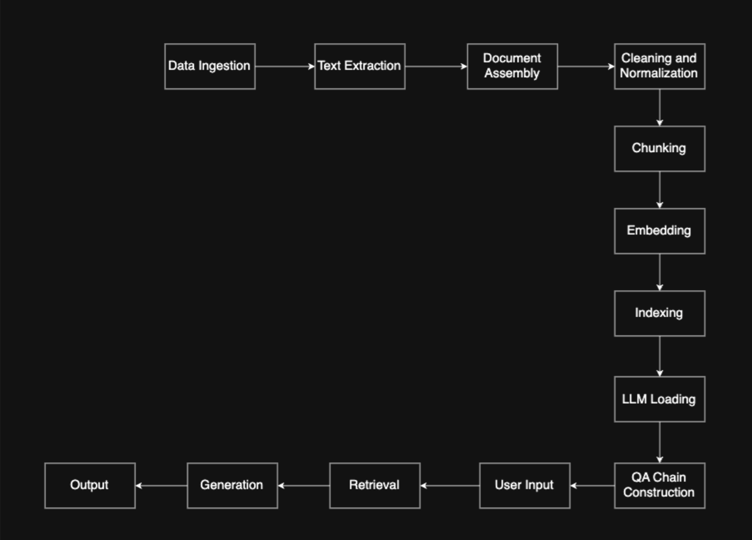
Your Approach
We extract and normalize the raw Unicode text, split it into overlapping chunks to respect the model’s context window and embed each chunk using a multilingual sentence transformer. These vectors are indexed in FAISS, enabling lightning-fast similarity search. When a user submits a Hindi question, the system retrieves thetop-k relevant excerpts and “stuff” them into the prompt of a small, instruction-tuned multilingual model (bigscience/mt0-small). The model then generates a concise, accurate answer entirely in Hindi, accompanied by citations of the source chunks.

Slide 5
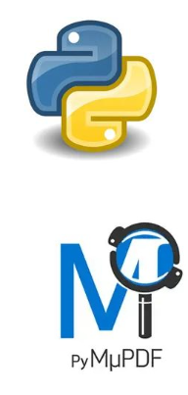
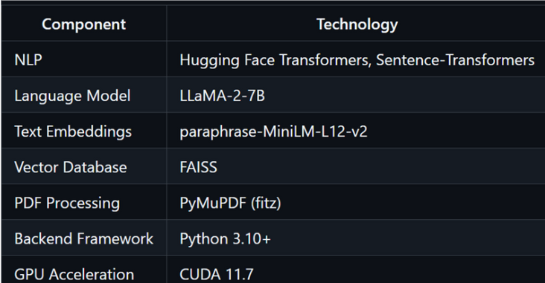


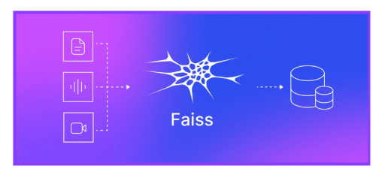
Tech Stacks and Frameworks Used
bigscience/mt0-small

Slide 6
Why you chose this problem statement?
We chose this project because we recognized a fundamental challenge in India: the vast and complex nature of legal documents makes them incredibly difficult for most people to understand. There is a pressing need for tools that can bridge the gap between dense legal language and the everyday questions of citizens, particularly in their preferred language, like Hindi. We were motivated to apply modern AI techniques, specifically Retrieval-Augmented Generation (RAG), to tackle this real-world problem. Our goal was to build a system that could empower people by making foundational legal texts, such as the Indian Constitution and Penal Code, directly accessible and understandable in Hindi.

Slide 7
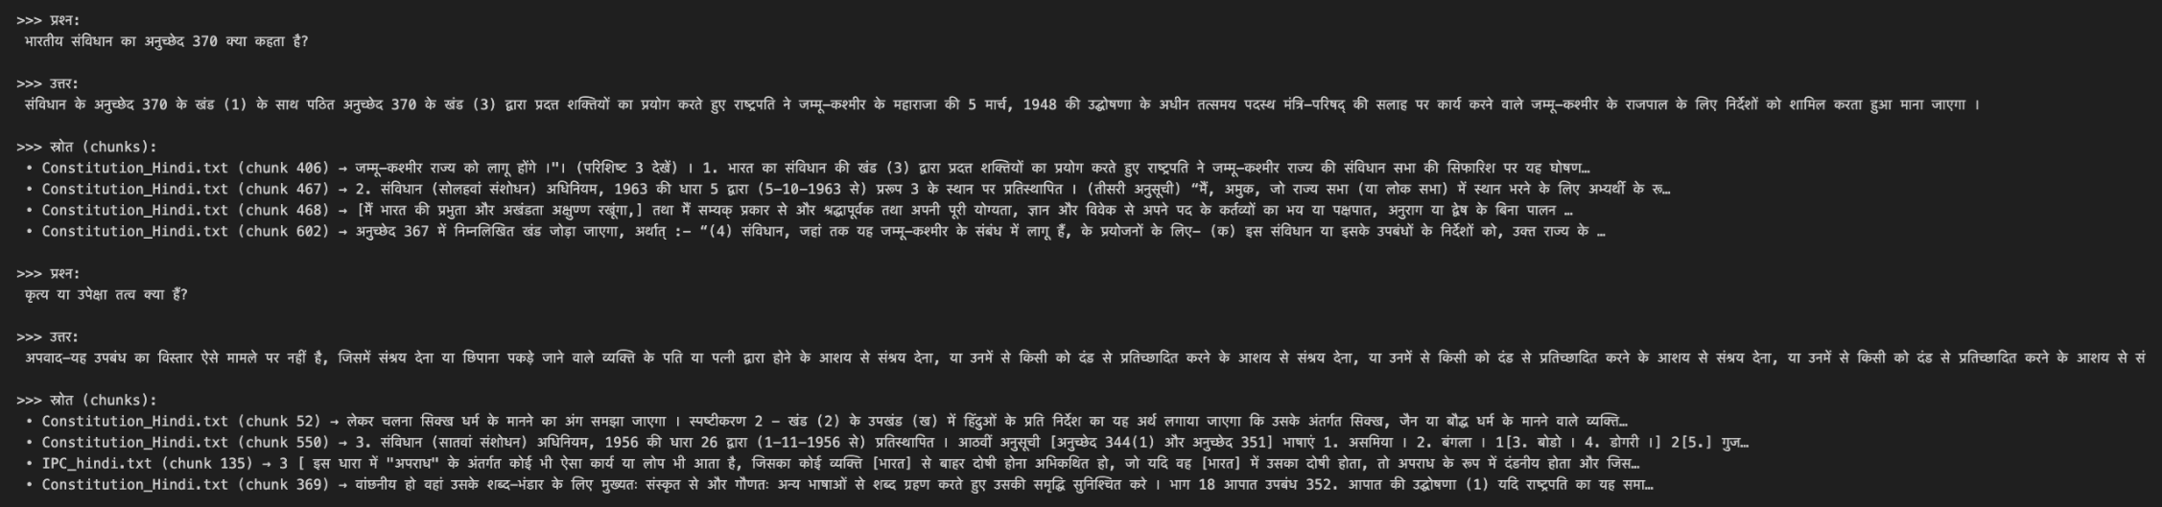
Screenshots from your solution

